Slide 1


Bucks Hackathon
Engagement Modeling

Slide 2
MEET THE TRITON
ALL-STAR TEAM
Aaditya Khanuja
Subhash Srinivasa
Alec Lichtenberger
Business Economics
Computer Science
Computer Science
Ajay Ramkarthik
Valmik Nahata
Computer Engineering
Data Science

Slide 3
AGENDA
01
PROBLEM STATEMENT
02
DATA PREPROCESSING
03
PROPENSITY AND CHURN MODELS
04
STRATEGIES AND SOLUTIONS
05
REFLECTIONS AND IMPROVEMENTS

Slide 4
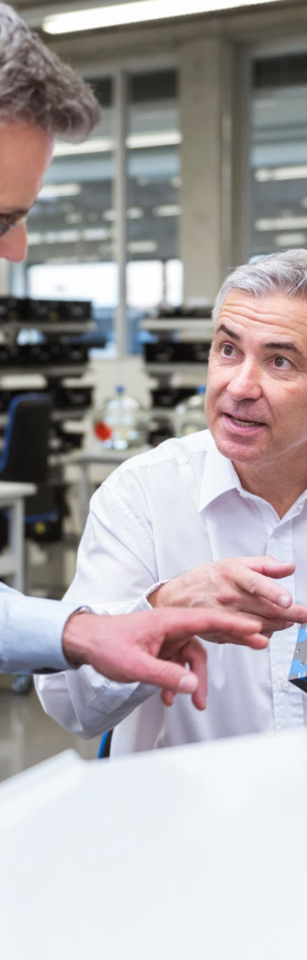

1
PROBLEM STATEMENT

Slide 5

Find ways to maximize the Milwaukee Bucks fan engagement with smarter strategies by leveraging churn and propensity models

Slide 6

2
DATA PREPROCESSING

Slide 7

Data Preprocessing
Aggregating
Consolidated and merged data on Account Number and Season Key
Quantifying
Strategically quantified necessary categorical variables before testing
Engagement Labeling
Explicitly defined and assigned labels to fans based on their ticketing levels

Slide 8

3
PROPENSITY AND CHURN MODELS

Slide 9
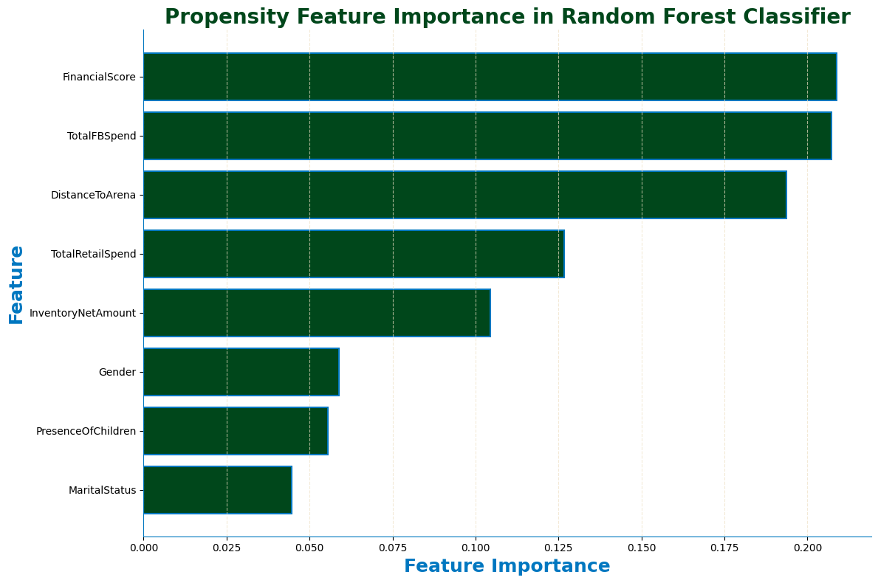
Propensity Model
01
Trained Random Forest Classifier on the data to predict the target variable Current Tier
02
03
81% accuracy when discerning propensity

Slide 10
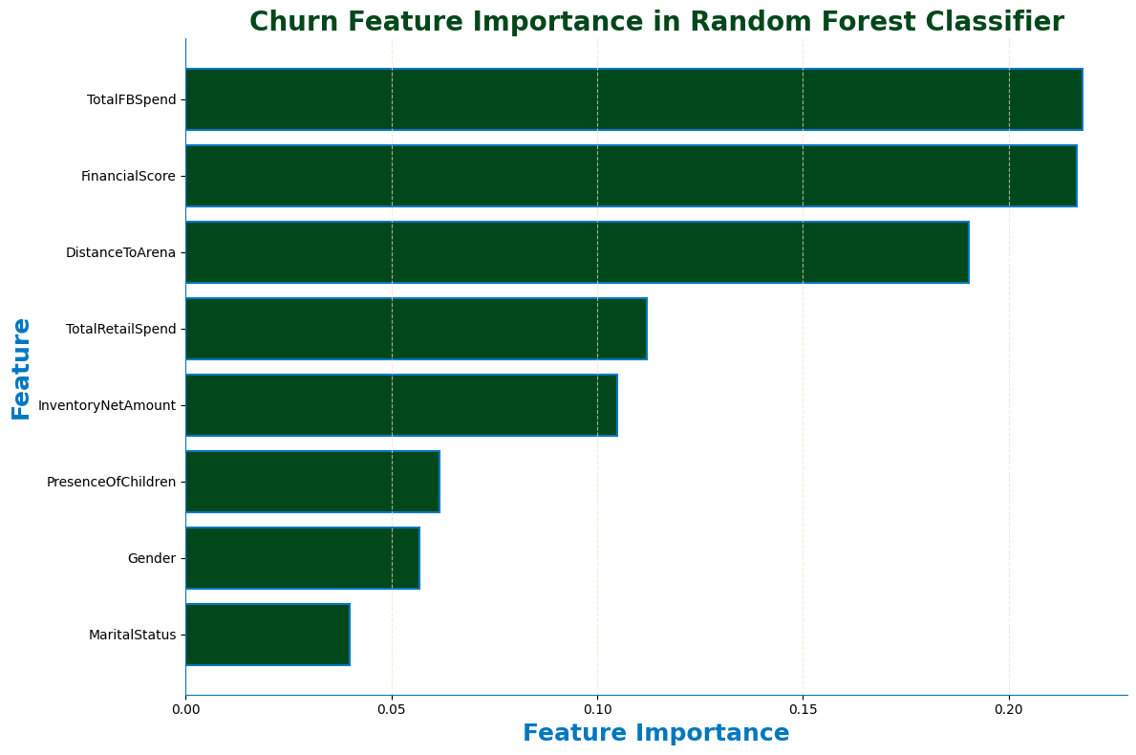
Churn Model
01
Trained Random Forest Classifier on the data to predict the target variable Current Tier
02
03
84% accuracy when discerning churn

Slide 11
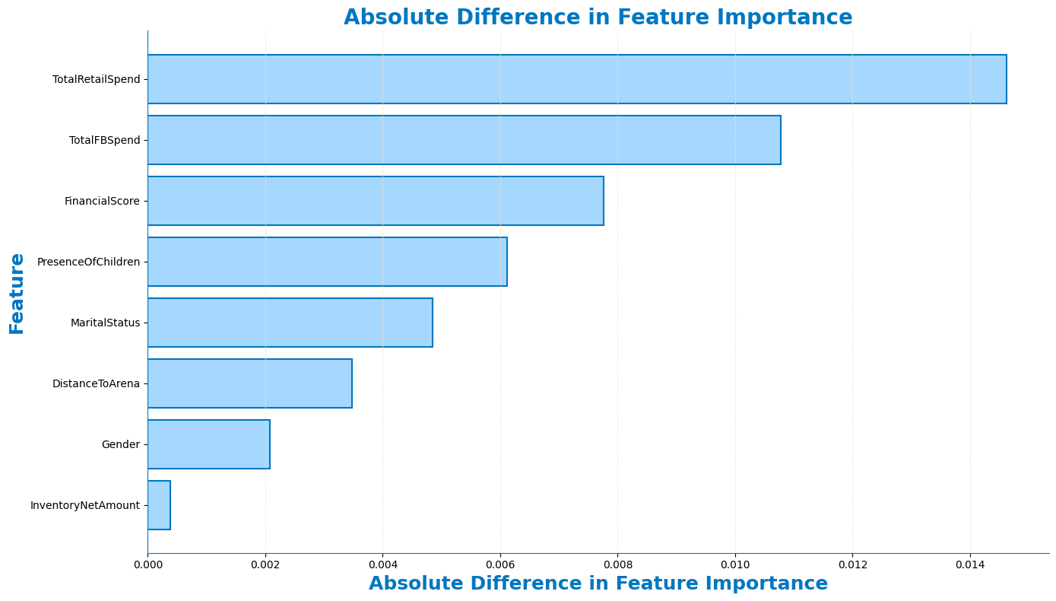
Propensity & Churn
Differences
Propensity and Churn Models have a relatively similar distribution of contributing features

Slide 12

4
STRATEGIES AND SOLUTIONS

Slide 13
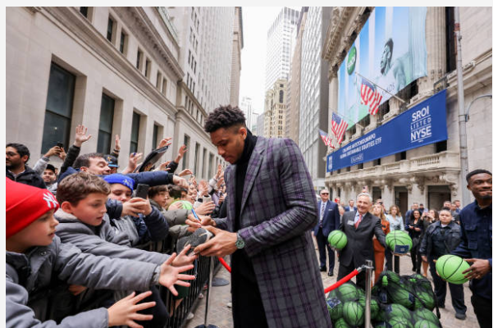
EXCLUSIVE FAN REFERRAL PROGRAMS
01
Refer family and friends to earn a promotional discount
02
Automatically enter giveaways for a chance to win signed merchandise and exclusive meet-and-greets with players, coaches, and team executives
Periodically test different types of incentives
03
Notes:
Connect this to financial score rating on propensity and churn models: Propensity and churn models showed that financial score was one of the most important predictors of churn and propensity score. Since pricing and cost are so important to engagement, offering discounts, we can increase

Slide 14
CROSSOVER EVENTS
Create unique crossover events with intellectual properties (influencers, video games, movies, etc.)
Bucks X _____ Theme Nights
Co-branded Merchandise

Slide 15
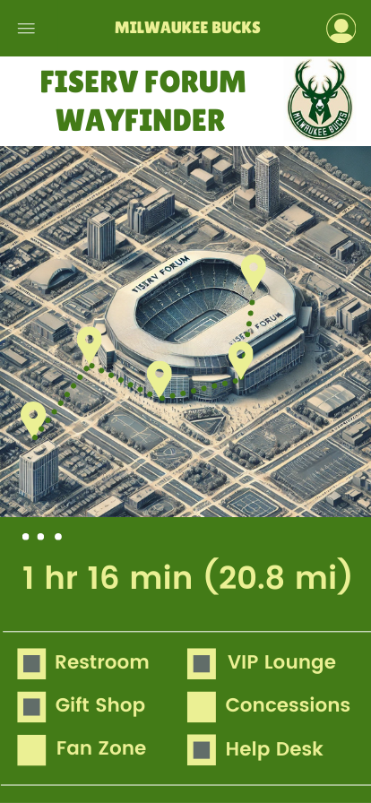
INTERACTIVE WAYFINDER
Map: Provides directions and a detailed aerial view around Fiserv Forum
Route Information: Displays the times and distances to and through Fiserv Forum
Points of Interest: Highlights key locations within and near Fiserv Forum

Slide 16
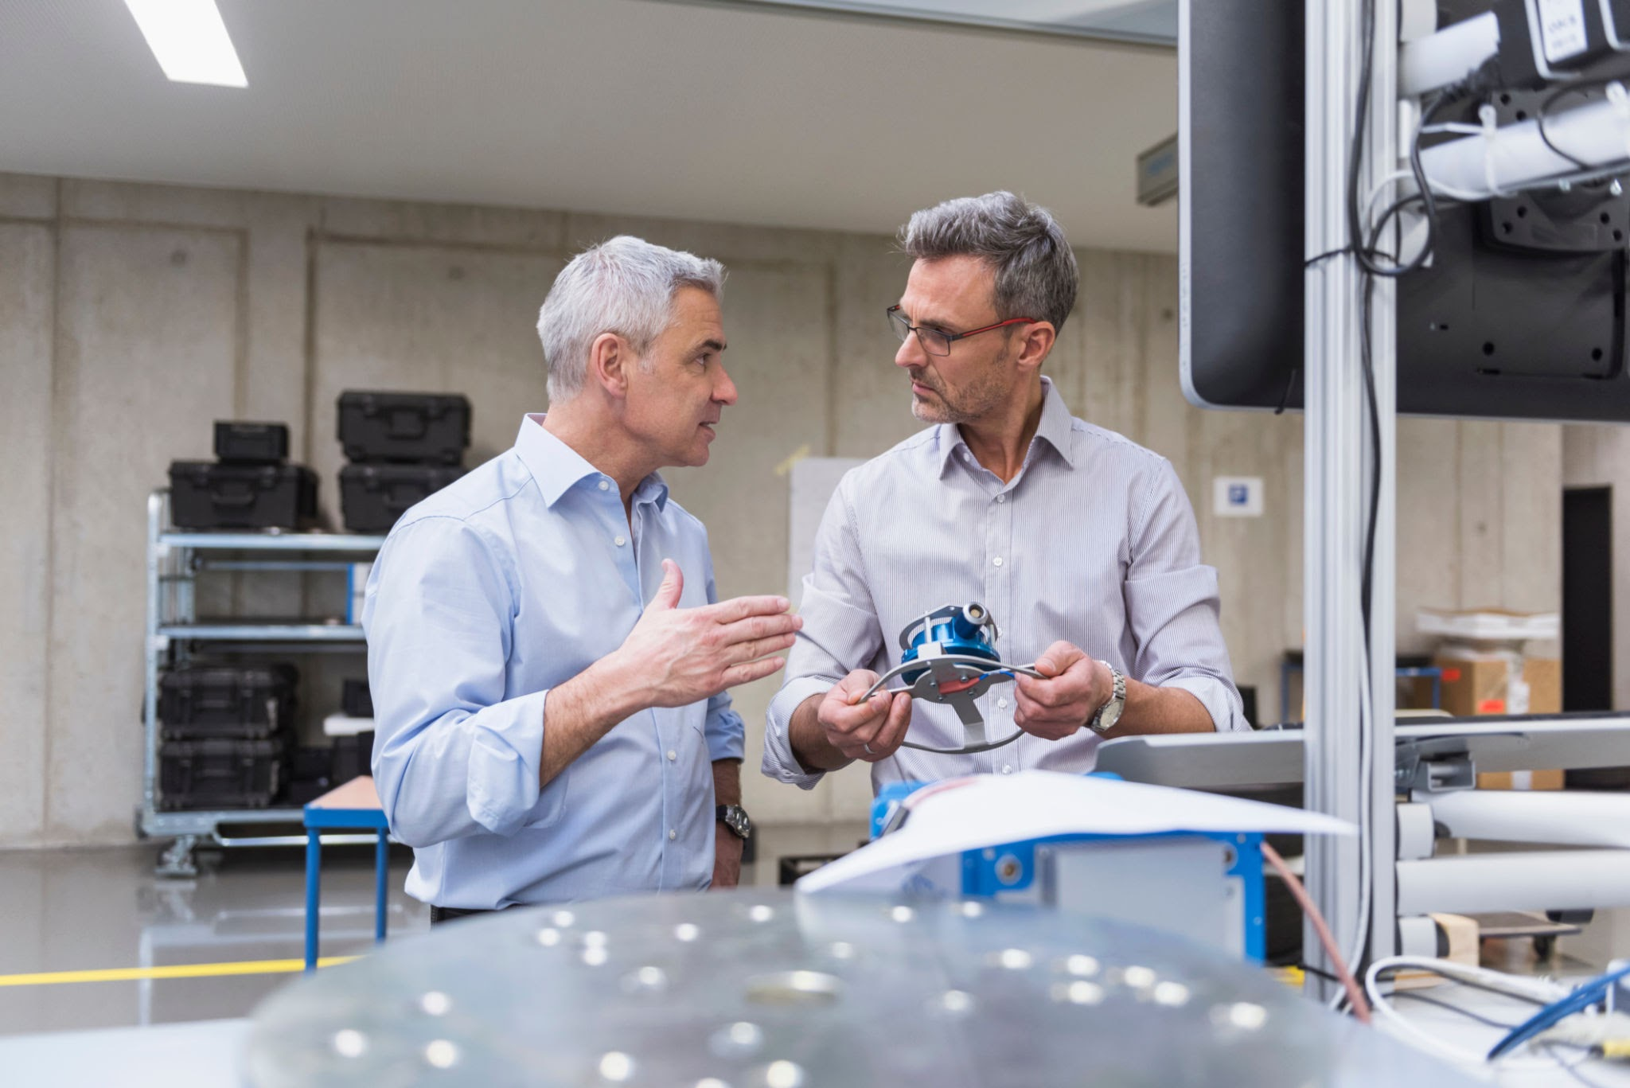

5
REFLECTIONS AND IMPROVEMENTS

Slide 17
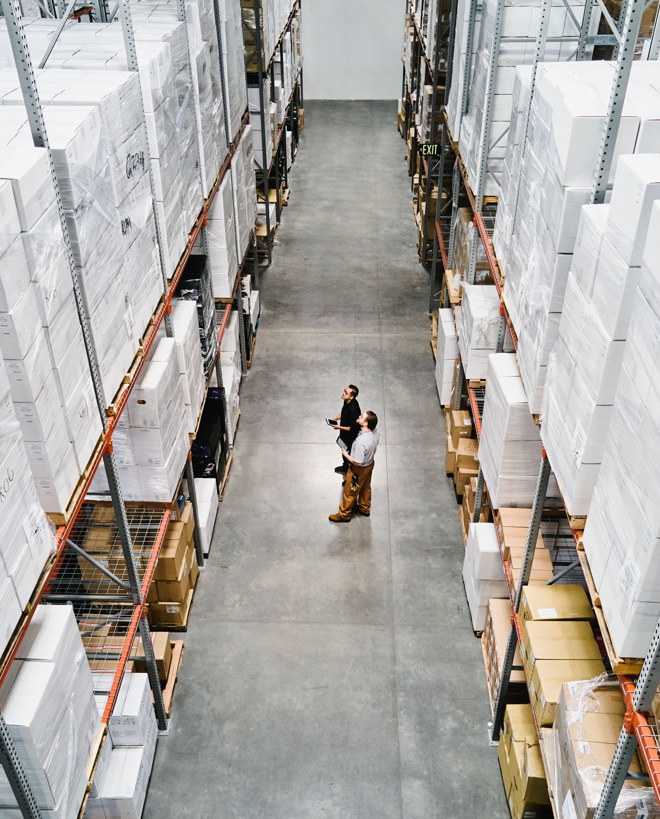
REFLECTIONS AND IMPROVEMENTS
1
Quantitative data to validate suggested strategies
2
Longitudinal data for static demographic data (financial score, number of kids, distance, etc.)
3
More data categories (age, seating, non-game engagement, etc.)

Slide 18
Thank You

